Slide 1

Replacement Educational Programs & Operations Levy
Collection Years 2024 & 2025

Slide 2

Introductions
Yvonne Walker, Superintendent
Morgan Thornton, Business Manager
Eric Sivertson, Director of Operations & Athletics

Slide 3
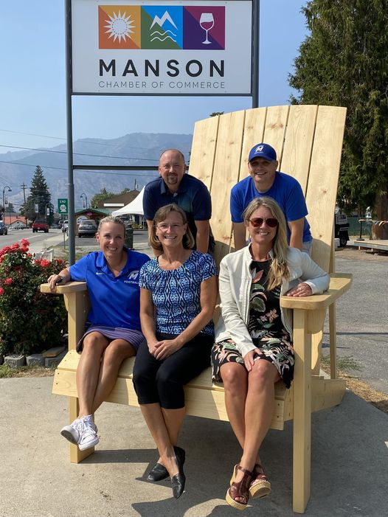
Manson Strong
The Manson community supports their schools

Slide 4
Voting History for Manson Schools
Source: OSPI 1463-GF, 1463-BI
Notes:
Community Support is a tradition in Manson
Know that great schools grow great communities

Slide 5

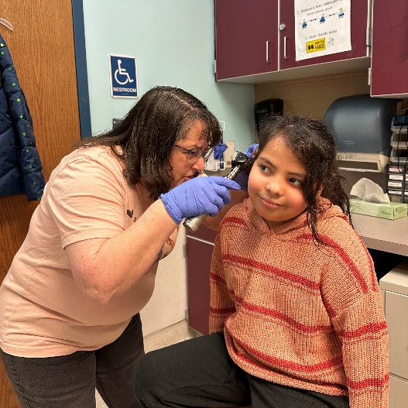
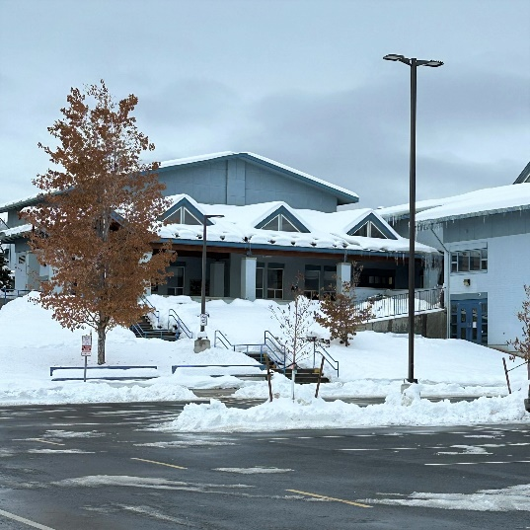
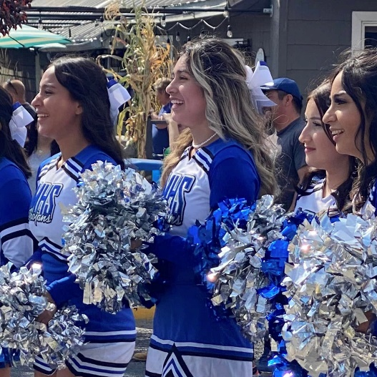
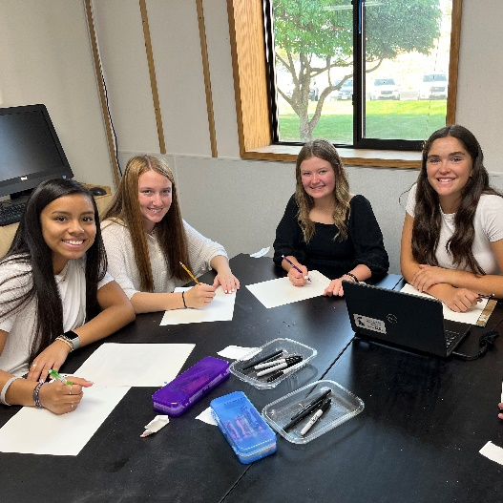
The Levy Helps Maintain Programs and Services
preschool
nurses & counselors
facilities & grounds
extra-curricular programs
instructional programs

Slide 6
Use of Levy Funding
Notes:
Local funds cover staff and programs not funded by the state apportionment model
Focused on providing comprehensive health and safety services to students and families
Enriching instruction, activities, athletics

Slide 7
Levy History for Manson Schools
Notes:
Local funds cover staff and programs not funded by the state apportionment model
Focused on providing comprehensive health and safety services to students and families
Enriching instruction, activities, athletics

Slide 8
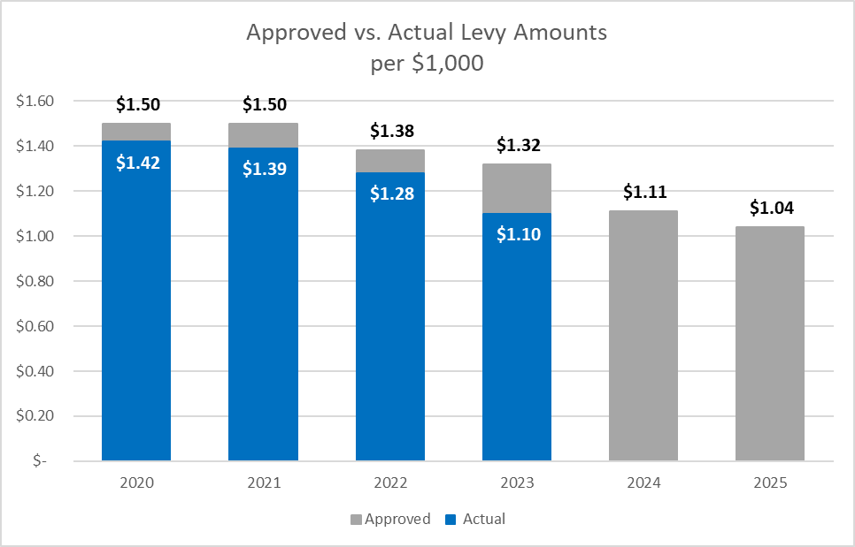
Historical and Projected Tax Rates
Notes:
Navy is projected

Slide 9
Historical and Projected EP&O Levy Amounts

Slide 10
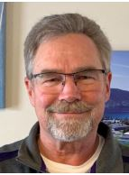
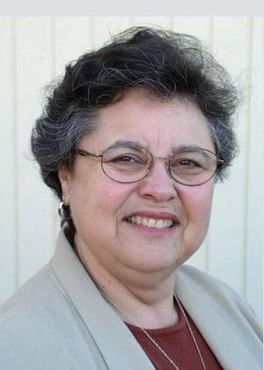
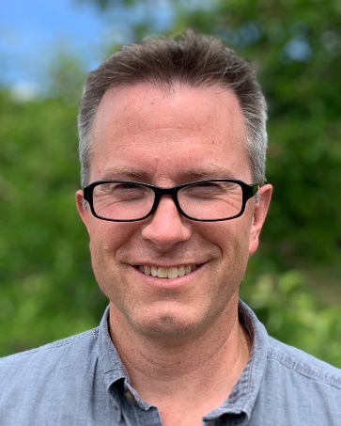
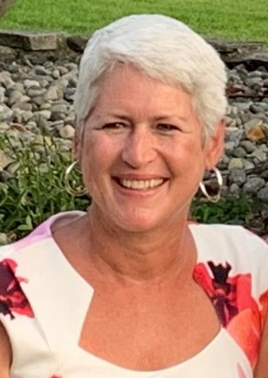
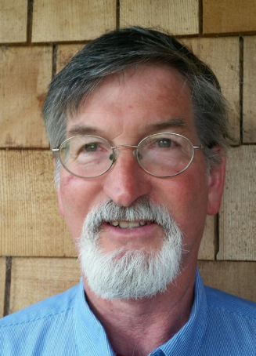
Continuing Tradition of Fiscal Responsibility
“We know your tax dollars are valuable to you and we have demonstrated a consistent pledge to keep your tax rates low and provide excellent educational services.”
Robin Bloch – Manson School Board President
Robin Bloch
District #1
Aurora Flores
District #2
Allen Torgesen
District #3
Susie Fox
District #4, At Large
Greg Neff
District #5, At Large
Notes:
Need a real picture to replace cartoon Allen

Slide 11
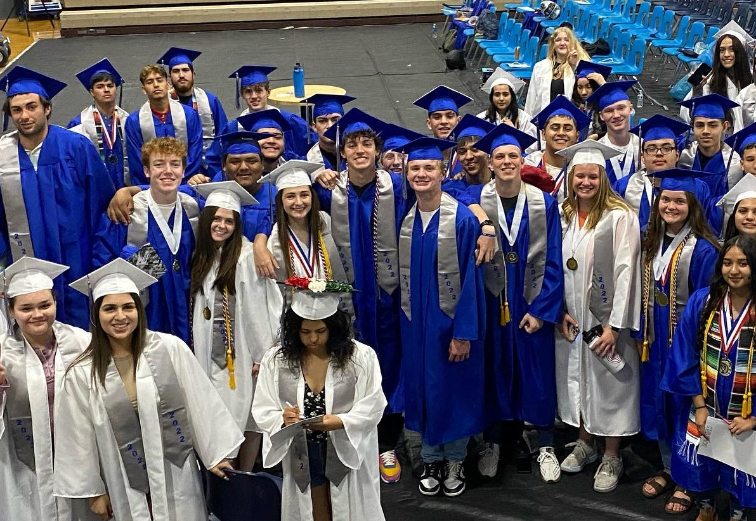
Thank You

